Slide 1
Computer Networks CS 3001 (BCS-5B) Lecture 3
Danyal Farhat
FAST School of Computing
NUCES Lahore

Slide 2

Chapter 3 Transport Layer
A note on the use of these PowerPoint slides:
We’re making these slides freely available to all (faculty, students, readers). They’re in PowerPoint form so you see the animations; and can add, modify, and delete slides (including this one) and slide content to suit your needs. They obviously represent a lot of work on our part. In return for use, we only ask the following:
If you use these slides (e.g., in a class) that you mention their source (after all, we’d like people to use our book!)
If you post any slides on a www site, that you note that they are adapted from (or perhaps identical to) our slides, and note our copyright of this material.
For a revision history, see the slide note for this page.
Thanks and enjoy! JFK/KWR
All material copyright 1996-2023
J.F Kurose and K.W. Ross, All Rights Reserved
Computer Networking: A Top-Down Approach 8th edition Jim Kurose, Keith Ross Pearson, 2020
Notes:
Version History
8.0 (April 2020)
All slides reformatted for 16:9 aspect ratio
All slides updated to 8th edition material
Use of Calibri font, rather that Gill Sans MT
Add LOTS more animation throughout
added new 8th edition material on QUIC, CUBIC, delay-based congestion control
lighter header font
8.2 (July 2023): changes from 8.0
minor updates throughout, but not much changes from 8.0

Slide 3
Transport layer: overview
Our goal:
understand principles behind transport layer services:
multiplexing, demultiplexing
reliable data transfer
flow control
congestion control
learn about Internet transport layer protocols:
UDP: connectionless transport
TCP: connection-oriented reliable transport
TCP congestion control

Slide 4

Transport layer: roadmap
Transport-layer services
Multiplexing and demultiplexing
Connectionless transport: UDP
Principles of reliable data transfer
Connection-oriented transport: TCP
Principles of congestion control
TCP congestion control
Evolution of transport-layer functionality

Slide 5








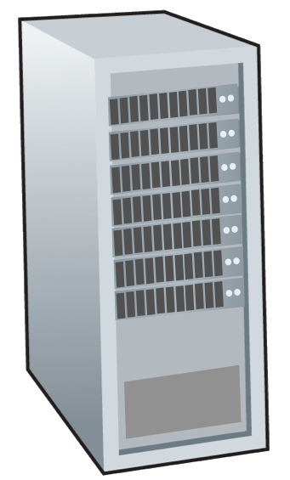







Transport services and protocols
application
transport
network
data link
physical
provide logical communication between application processes running on different hosts
mobile network
national or global ISP
transport protocols actions in end systems:
sender: breaks application messages into segments, passes to network layer
receiver: reassembles segments into messages, passes to application layer
logical end-end transport
local or regional ISP
home network
content
provider
network
application
transport
network
data link
physical
datacenter
network
two transport protocols available to Internet applications
TCP, UDP
enterprise
network
Notes:
By logical communication , we
mean that from an application’s perspective, it is as if the hosts running the processes
were directly connected; in reality, the hosts may be on opposite sides of the
planet, connected via numerous routers and a wide range of link types. Application
processes use the logical communication provided by the transport layer to send
messages to each other, free from the worry of the details of the physical infrastructure
used to carry these messages.
Let’s look at each of these three (logical communications, actions,

Slide 6
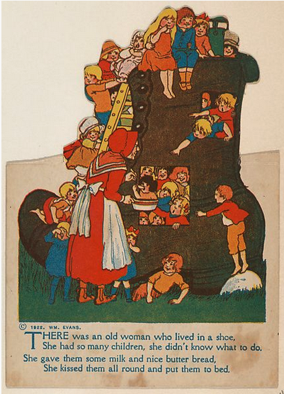
Transport vs. network layer services and protocols
household analogy:
12 kids in Ann’s house sending letters to 12 kids in Bill’s house:
hosts = houses
processes = kids
app messages = letters in envelopes
transport protocol = Ann and Bill who demux to in-house siblings
network-layer protocol = postal service

Slide 7
Transport vs. network layer services and protocols
household analogy:
transport layer: communication between processes
relies on, enhances, network layer services
12 kids in Ann’s house sending letters to 12 kids in Bill’s house:
hosts = houses
processes = kids
app messages = letters in envelopes
transport protocol = Ann and Bill who demux to in-house siblings
network-layer protocol = postal service
network layer: communication between hosts

Slide 8
Transport Layer Actions
Sender:
application
application
is passed an application-layer message
app. msg
determines segment header fields values
T_{h}
transport
app. msg
transport
T_{h}
creates segment
network (IP)
network (IP)
passes segment to IP
link
link
physical
physical

Slide 9
Transport Layer Actions
Receiver:
application
receives segment from IP
application
checks header values
transport
transport
app. msg
extracts application-layer message
network (IP)
network (IP)
demultiplexes message up to application via socket
link
link
physical
physical
app. msg
T_{h}

Slide 10
Two principal Internet transport protocols
application
transport
network
data link
physical
TCP: Transmission Control Protocol
reliable, in-order delivery
congestion control
flow control
connection setup
UDP: User Datagram Protocol
unreliable, unordered delivery
no-frills extension of “best-effort” IP
services not available:
delay guarantees
bandwidth guarantees
mobile network
national or global ISP
logical end-end transport
local or regional ISP
home network
content
provider
network
application
transport
network
data link
physical
datacenter
network
enterprise
network

Slide 11
Thank You!

